Slide 1
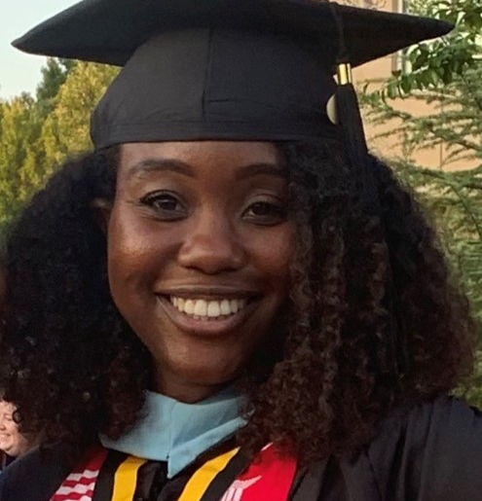
Ms. Kristen Turner Physical Science 8th, Gifted and Honors
6 Years of Experience
College Attended:
THE Fort Valley State University-BS Chemistry & Kennesaw State University- MED
Attended Sandtown as an 8th grader its opening year

